Slide 1
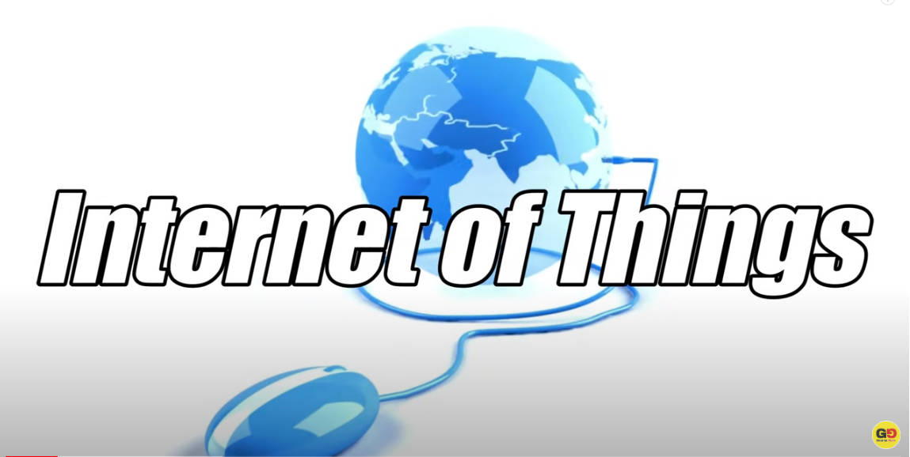
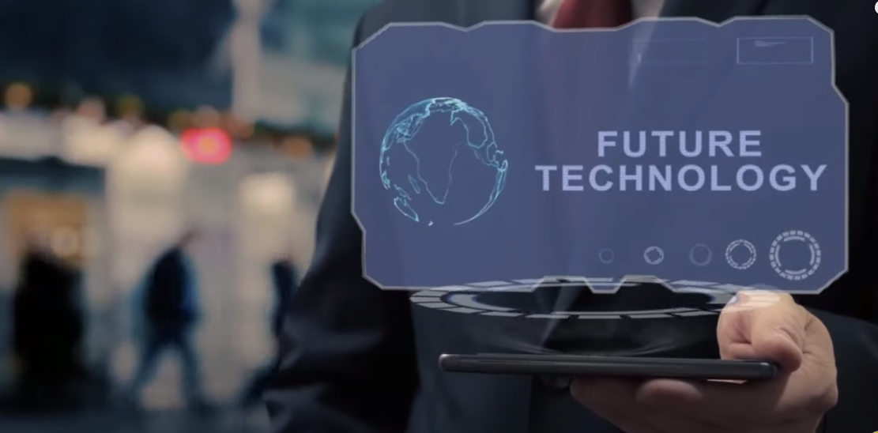

Slide 2
Contents
History of Innovation Cycles
What is IoT & Why it is needed
IoT Cycle & how does IoT works
IoT Components, Categories, Uses & Risks
IoT Network & Connectivity Options
IoT Applications and Smart Solutions

Slide 3
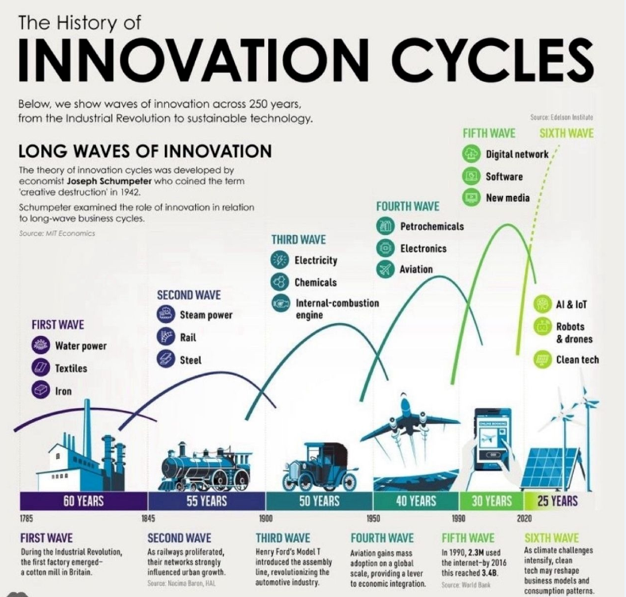

Slide 4
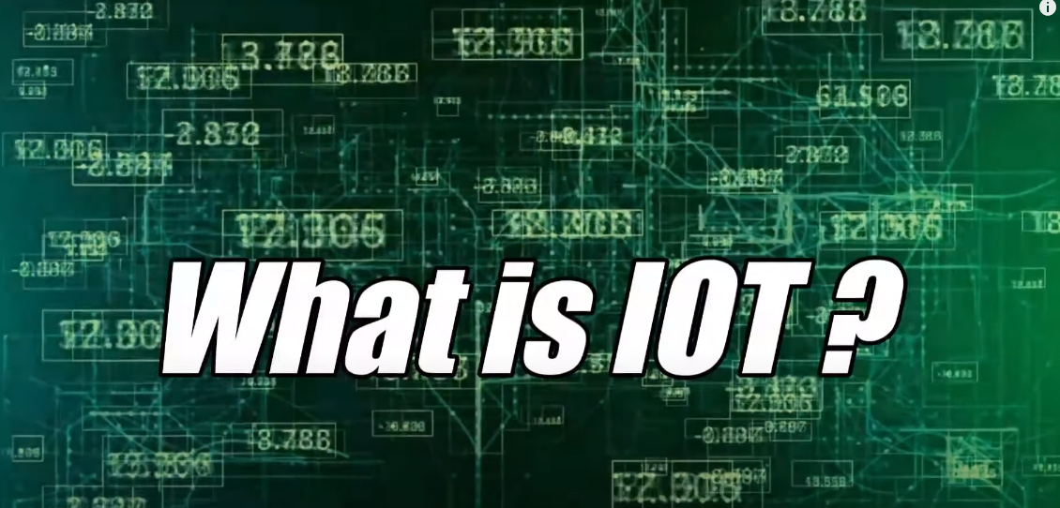
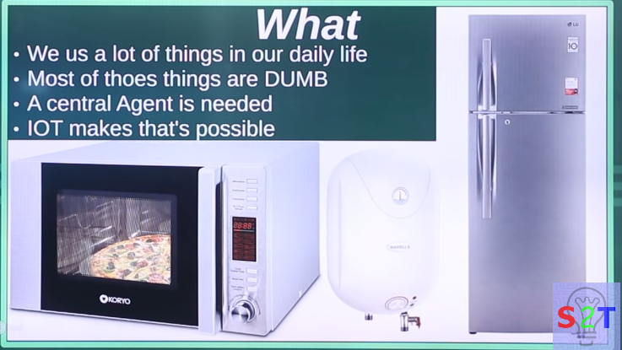

IOT – Internet of Things
What
We use a lot of things in our daily life
Most of those things are DUMB
A central agent is needed
IOT makes that’s possible

Slide 5
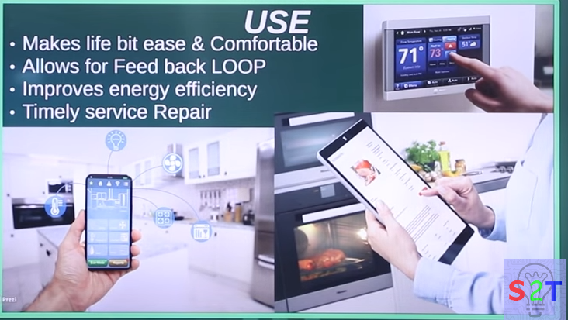
USE
Makes life a bit easier & more comfortable
Allows for feedback loop.
Improves energy efficiency.
Timely service repair.

Slide 6
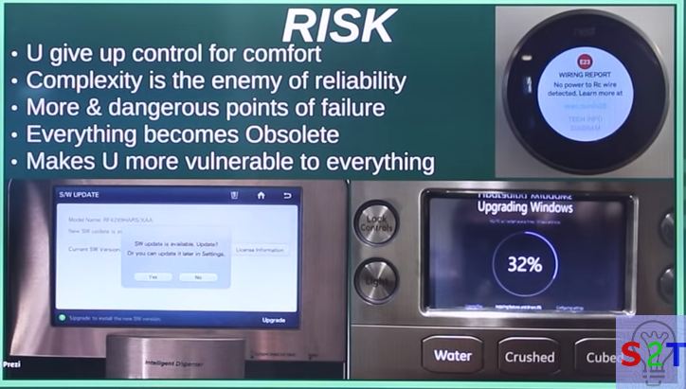
RISK
You are giving up control for comfort
Complexity being the enemy of reliability
More and dangerous points of failure
Everything becoming obsolete
Makes you more vulnerable to everything

Slide 7
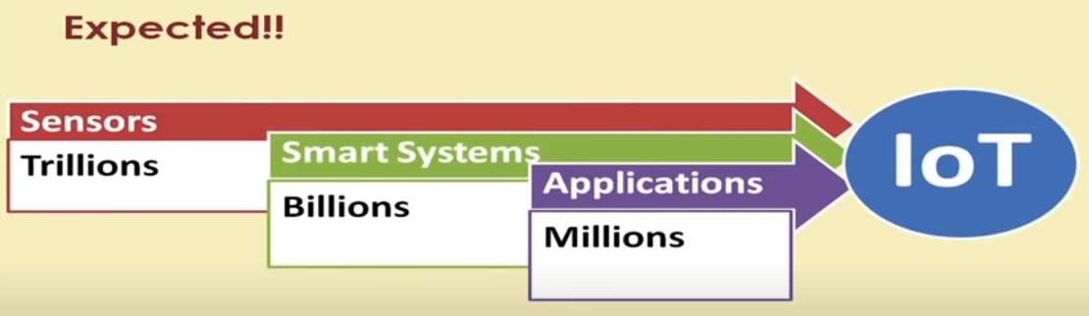
Who invented IoT Need to Know its components and connectivity Options
Since Kevin Ashton invented the concept of the internet of things in 1999, the number of IoT devices available has grown from zero to around 27 billion.
Today, connectivity options include proprietary and cellular wireless transceivers that broadcast data to IoT devices a few feet or a few miles away and satellites that transmit data from orbit.

Slide 8
IoT Cycle
Devices
Connectivity
Any device
Any body
Any where
Any Business
Any Network
Any time
User Interface
Data Process

Slide 9
How does IoT work?
Internet of Things platform
An IoT platform manages device connectivity. It can be a software suite or a cloud service. The purpose of an IoT platform is to manage and monitor hardware, software, processing abilities, and application layers.
Sensor technologies
IoT sensors, sometimes called smart sensors, convert real-world variables into data that devices can interpret and share. Many different types of sensors exist. For example, temperature sensors detect heat and convert temperature changes into data. Motion sensors detect movement by monitoring ultrasonic waves and triggering a desired action when those waves are interrupted.
Unique identifiers
The core concept of the IoT is communication among devices and users. Unique identifiers (UIDs) establish the context of a device within the larger network to enable this communication. Identifiers are patterns, like numeric or alphanumeric strings. One example of a UID that you might be familiar with is an internet protocol (IP) address. They can identify a single device (instance identifier) or the class to which that device belongs (type identifier).

Slide 10
How does IoT work?
Internet connectivity
Sensors can connect to cloud platforms and other devices through a host of network protocols for the internet. This enables communication between devices.
Artificial intelligence (AI) and machine learning
Natural language processing (NLP) in IoT devices makes it easier for users to input information and interact with devices. One common example of an IoT device that utilizes NLP technology is the Amazon Alexa. Machine learning also enhances the analytical capabilities of IoT devices.
Edge computing
Edge computing is a computing framework. It aims to conserve resources and speed up response time by moving computational resources like data storage closer to the data source. The IoT accomplishes this by utilizing edge devices like IoT gateways.

Slide 11
Features of IOT
The most important features of IoT on which it works are connectivity, analyzing, integrating, active engagement, and many more. Some of them are listed below:
Connectivity :
Connectivity refers to establish a proper connection between all the things of IoT to IoT platform it may be server or cloud. After connecting the IoT devices, it needs a high speed messaging between the devices and cloud to enable reliable, secure and bi-directional communication.
Analyzing :
After connecting all the relevant things, it comes to real-time analyzing the data collected and use them to build effective business intelligence. If we have a good insight into data gathered from all these things, then we call our system has a smart system.
Integrating :
IoT integrating the various models to improve the user experience as well.
Artificial Intelligence :
IoT makes things smart and enhances life through the use of data. For example, if we have a coffee machine whose beans have going to end, then the coffee machine itself order the coffee beans of your choice from the retailer.

Slide 12
Features of IOT
Sensing :
The sensor devices used in IoT technologies detect and measure any change in the environment and report on their status. IoT technology brings passive networks to active networks. Without sensors, there could not hold an effective or true IoT environment.
Active Engagement :
IoT makes the connected technology, product, or services to active engagement between each other.
Endpoint Management :
It is important to be the endpoint management of all the IoT system otherwise, it makes the complete failure of the system. For example, if a coffee machine itself order the coffee beans when it goes to end but what happens when it orders the beans from a retailer and we are not present at home for a few days, it leads to the failure of the IoT system. So, there must be a need for endpoint management.

Slide 13
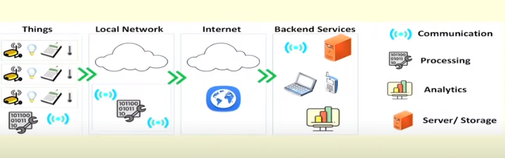
Scenarios of IoT

Slide 14
IoT Gateways
Software
Switching
Routing
Local Network
Protocol Connection
Global Network
Wired/Wireless Connections
Wired/Wireless Connections
Firewall & VPN
Security
Processor

Slide 15
IoT Components
Device The Thing
Local Network
Internet
Backend Services
Applications

Slide 16
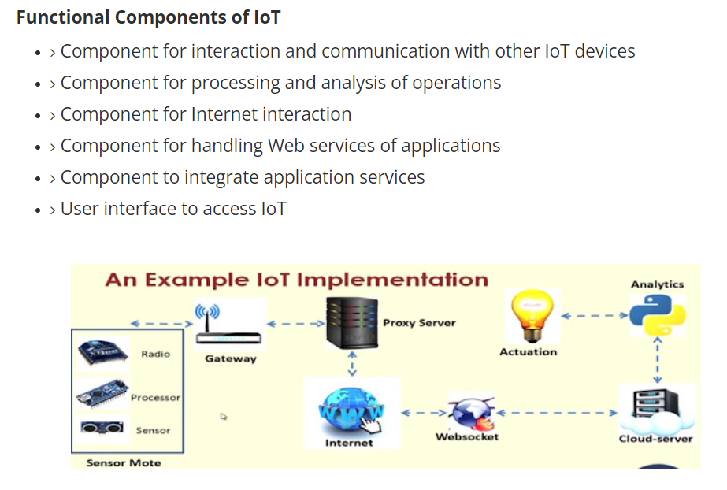

Slide 17
Technical Deviation From Regular Web
IoT Stack
Web Stack
Application
Management
Web Application
Binary, JSON, CBOR
HTML,XML,JSON
MQTT, CoAP, XMPP, AMQP
HTTP,DHCP,DNS,TLS/SSL
UDP, DILS
TCP, UDP
IPv6
IPv6, IPv4, IPSec
6LoWPAN
IEEE.802.15.4MAC
Ethernet, DSL,ISDN, Wireless, LAN,WiFi
IEEE.802.15.4PHY/Radio

Slide 18
IoT Interdependencies
Embedded Device
Application
Virtual
Machine
Real Time Kernel
Power Management
HTTP
Client
Radios
Sensor
Actuator
6loWPAN
Bluetooth
ZigBEE
MQTT
Client
Web
WiFi
Ethernet
Low-WiFi
CoAP
Client

Slide 19
IOT & Associated Technology
SDN
Big Data
Cloud
M2M
Telemedicine
3G/4G/LTE
5G
IoT

Slide 20
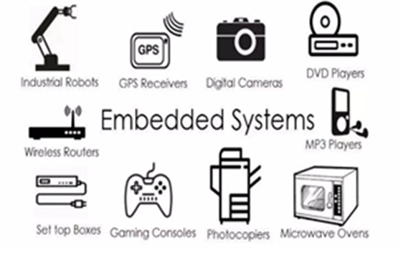
What is Embedded System
An embedded system is an electronic/electro-mechanical system designed to perform a specific function and a combination of hardware and firmware (software).
Every embedded system is unique and the hardware as well as the firmware is highly specialized to the application domain.
Embedded system are becoming an inevitable part of any product or equipment, industrial control, consumer products, etc.

Slide 21
IoT Categories
Industrial IoT
IoT device connects to an IP network and the global network.
Communication between the nodes done using regular as well as industry specific technologies.
Consumer IoT
IoT device communicates with in the locally networked devices.
Local communication is done mainly via Bluetooth, Zigbee or Wifi.
Generally limited to local communication by a Gateway.

Slide 22
IoT Challenges
Security
Interfacing
Scalability
Interoperability
Energy efficiency
Data storage
Bandwidth management
Data Analytics
Modeling and Analysis
Complexity management (e.g., SDN)

Slide 23
Considerations
Communication between the IoT devices and the outside world dictates the network architecture.
Choice of communication technology dictates the IoT device hardware requirements and costs.
Due to the presence of numerous applications of IoT enabled devices, a single networking paradigm not sufficient to address all the needs of the consumer or the IoT device.

Slide 24
Complexity of Networks
Growth of Networks
Interference among devices
Network management
Heterogeneity in the networks
Protocols standardization within networks

Slide 25
Wireless Networks
Traffic and load management
Variations in wireless networks – Wireless Body Area Networks and other Personal Area Networks
Interoperability
Network management
Overlay networks
Scalability
Flexibility within internet
IoT integration
Large scale deployment
Real-time connectivity of billions of devices

Slide 26

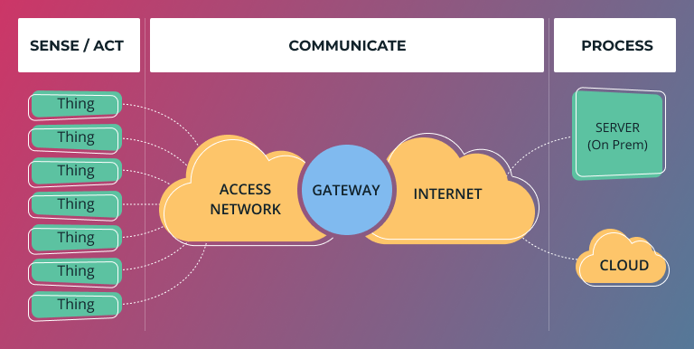
RISKS
The Internet of Things (IoT) introduces specific risks and challenges due to the interconnected nature of devices and the massive amounts of data they generate. Some of the key risks associated with IoT include:
Security Risks:
IoT devices may become targets for cyberattacks, leading to unauthorized access, data breaches, or manipulation of device functionalities. Insecure communication channels, weak authentication, and inadequate encryption can contribute to security vulnerabilities.
Privacy Concerns:
The extensive data collection capabilities of IoT devices raise privacy concerns. Personal and sensitive information may be collected without proper consent, leading to potential misuse or unauthorized access to individuals' data.

Slide 27
RISKS
Data Integrity and Quality:
Ensuring the accuracy and reliability of data generated by IoT devices is crucial. Malfunctions, errors, or intentional manipulation of data can lead to incorrect conclusions and decisions.
Lack of Standardization:
The absence of standardized protocols and security measures across IoT devices can create interoperability issues and make it challenging to implement consistent security practices. This lack of standardization may hinder the overall security of IoT ecosystems.

Slide 28
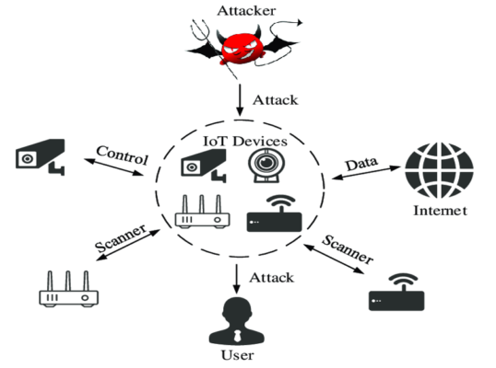
RISKS
Device Management and Maintenance:
Managing a large number of diverse IoT devices can be complex. Issues such as firmware updates, patch management, and device maintenance become critical to address vulnerabilities and ensure the ongoing security of the devices.
Network Vulnerabilities:
The communication networks connecting IoT devices are susceptible to various attacks, including denial-of-service (DoS) attacks. A compromised network can disrupt the functionality of IoT devices and compromise data integrity.
Supply Chain Risks:
The global supply chain for IoT components and devices introduces potential risks related to the security of the supply chain. Malicious actors may exploit vulnerabilities in the supply chain to compromise the integrity of IoT devices.

Slide 29
Regulatory Compliance:
Compliance with data protection and privacy regulations is a significant concern in the IoT space. Non-compliance may lead to legal consequences and reputational damage for organizations deploying IoT solutions.
Physical Security Risks:
Physical tampering with IoT devices can pose risks, especially in critical infrastructure and industrial applications. Adequate physical security measures are necessary to prevent unauthorized access or manipulation.
Scalability Challenges:
As IoT ecosystems grow in scale, managing the security of a large number of devices becomes more challenging. Ensuring consistent security practices and updates across a vast network of devices requires careful planning.

Slide 30
Sensor
They Perform some input function by sensing or feeling the physical changes in characteristics of a system in response to a stimuli.
For example heat is converted to electrical signals in a temperature sensor, or atmospheric pressure is converted to electrical signals in a barometer.
Sensor Types
Light
Temperature
Force
Position
Speed
Sound
Chemical
Light Dependent
Photo-Diode
Thermocouple
Thermistor
Strain gauge
Pressure Sensor
Potentiometers, Encoder
Opto-Coupler
Reflective/Opto-Coupler
Doppler Effect Sensor
Carbon Microphone
Piezoelectric Crystal
Liquid Chemical Sensor
Gaseous Chemical Sensor

Slide 31
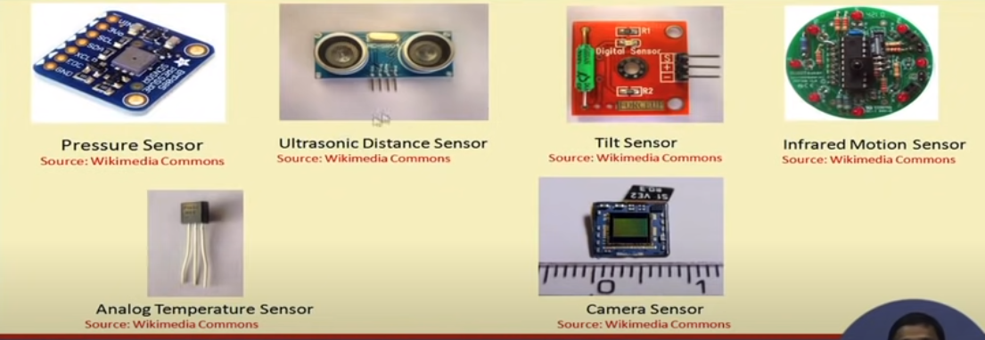
Some types of Errors in Sensors 1- Hysteresis: Due to this error output value vary, typically in analog sensors , magnetic Sensors , heating of metal strip. 2- Drift: Output signal slowly changes independent of the measured property. 3- Noise: Random deviation of the signal that varies of time.

Slide 32
Actuator
An actuator is component of a machine or system that moves or controls the mechanism or the system.
An actuator is the mechanism by which a control system acts upon an environment.
An actuator requires a control signal and a source of energy.
Upon receiving a control signal, the actuator responds by converting the energy into mechanical motion.
The control system can be simple (a fixed mechanical or electronic system). Software-based (e.g. a printer driver, robot control system), a human, or any other input.
Actuator Types
Hydraulic
Pneumatic
Electrical
Thermal / Magnetic
Mechanical

Slide 33
Shape Memory Polymers
Shape memory polymer (SMP) actuators function similar to our muscles, even providing a response to a range of stimuli such as light, electrical, magnetic, heat and moisture changes.
SMP exhibits surprising features such a low density, high strain recovery, biocompatibility, and biodegradability.
Soft Actuators
Soft actuators (e.g. polymer based) are designed to handle fragile objects like fruit harvesting in agriculture or manipulating the internal organs in biomedicine.
They typically address challenging tasks in robotics.
Soft actuators produce flexible motion due to the integration of microscopic changes at the molecular level into a macroscopic deformation of the actuator materials.

Slide 34
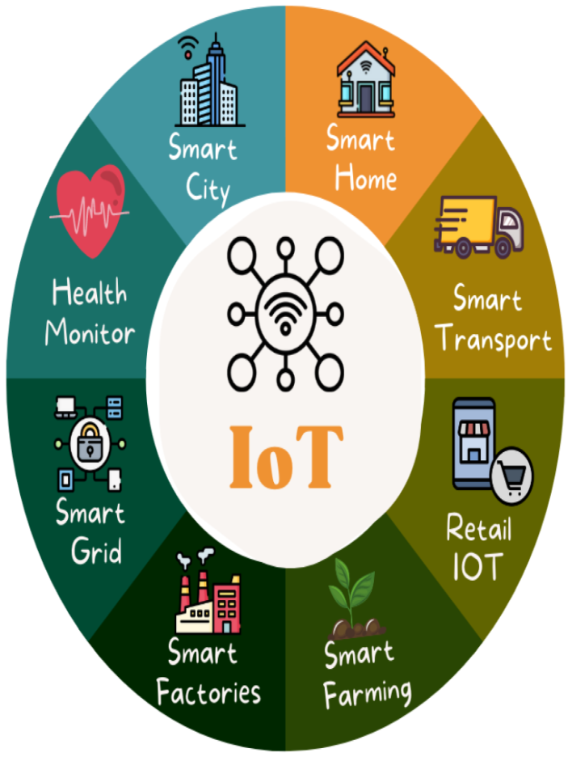
Applications of IoT
Smart Home Automation:
IoT devices such as smart thermostats, lighting systems, security cameras, and connected appliances enable homeowners to automate and control various aspects of their homes remotely.
Healthcare Monitoring:
Wearable devices equipped with sensors can monitor vital signs, track physical activity, and send real-time health data to healthcare professionals, providing timely insights and improving patient care.
Industrial Internet (Industry 4.0):
IoT is extensively used in industries for predictive maintenance, asset tracking, and process optimization. Connected sensors on machines and equipment enable proactive maintenance, reducing downtime and improving efficiency.

Slide 35
Applications of IoT
Smart Cities:
IoT contributes to the development of smart cities by integrating sensors and data analytics into urban infrastructure. This includes smart traffic management, waste management, energy-efficient street lighting, and environmental monitoring.
Agricultural Monitoring:
IoT devices, such as soil sensors and drones, help farmers monitor crop conditions, manage irrigation more efficiently, and optimize farming practices for increased yield and sustainability.
Retail and Inventory Management:
Retailers use IoT for inventory tracking, supply chain optimization, and enhancing the overall shopping experience through technologies like smart shelves and connected beacons.

Slide 36
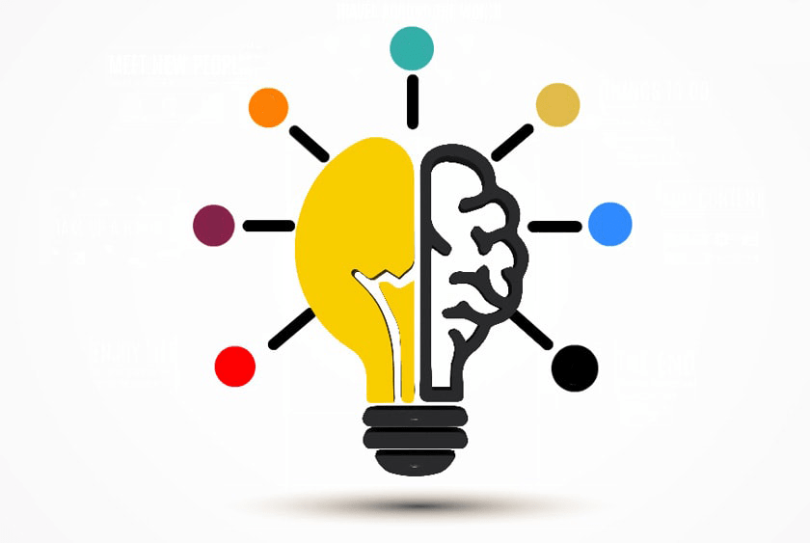
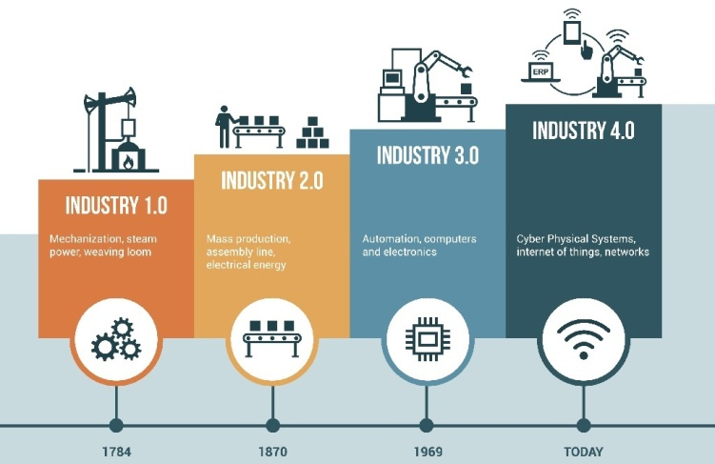
Applications of IoT
Environmental Monitoring:
IoT sensors are deployed for monitoring and collecting data on environmental conditions, including air and water quality, to support sustainable practices and early detection of environmental issues.
Connected Vehicles:
IoT is integrated into vehicles for real-time monitoring, predictive maintenance, and enhancing safety. Connected cars can communicate with each other and with traffic infrastructure to improve traffic flow and reduce accidents.
Energy Management:
Smart meters, sensors, and connected devices help optimize energy consumption in homes, businesses, and industries, contributing to energy efficiency and cost savings.

Slide 37
Applications of IoT
Supply Chain Visibility:
IoT is used to track and monitor goods throughout the supply chain. This provides real-time visibility, improves logistics, and helps prevent issues such as theft or spoilage.
Asset Tracking:
Companies use IoT to track the location and condition of valuable assets, equipment, and inventory, leading to better asset management and increased operational efficiency.

Slide 38
INTERNET OF THINGS INNOVATIVE EXAMPLES
You likely use IoT devices every day. The list below outlines a few IoT devices that you may be familiar with:
Smart home devices. Smart devices are interactive electronics that use wireless connections to understand user instructions. To an extent, smart home devices like thermostats and home security systems can work autonomously to assist with daily tasks. For example, you may program your smart thermostat to adjust automatically to a cooler setting before you arrive home from work. Or, you may receive a security camera notification to inform you that someone is at the door when you are not home.
Wearable technologies. One of the most common Internet of Things examples is smartwatches. Wearable IoT technology like Fitbits and Apple Watches connect to other devices (like your smartphone) to share data. They typically also connect to the internet to track GPS locations.
Personal medical devices. Personal medical devices like pacemakers are also IoT devices. Remote medical devices can help monitor and share a patient's vital signs or detect early signs of health issues for fast intervention.
Autonomous vehicles. Self-driving cars and other connected vehicles rely on the internet to share real-time information. Sensors throughout the vehicle help map its surroundings, transmit camera footage, and respond to traffic signals.

Slide 39
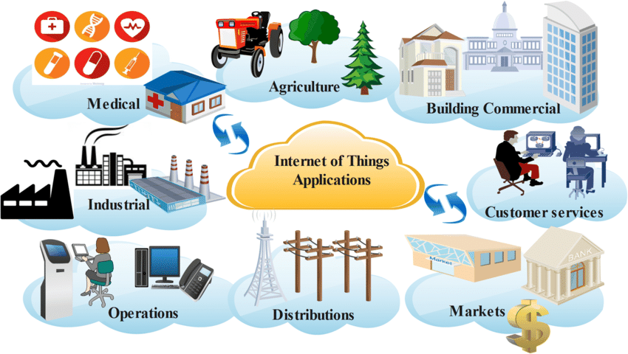
INTERNET OF THINGS INNOVATIVE EXAMPLES

Slide 40
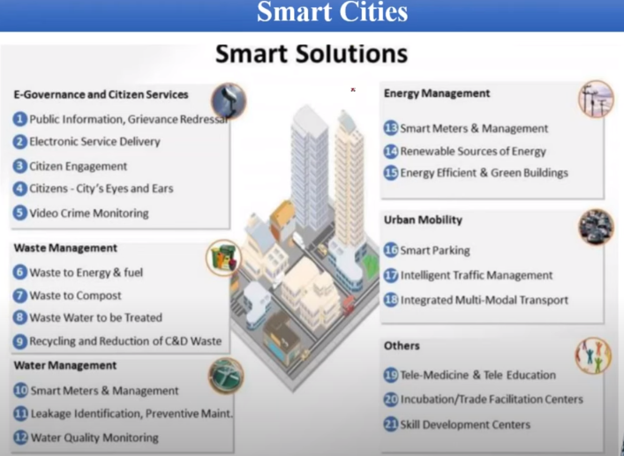

Slide 41
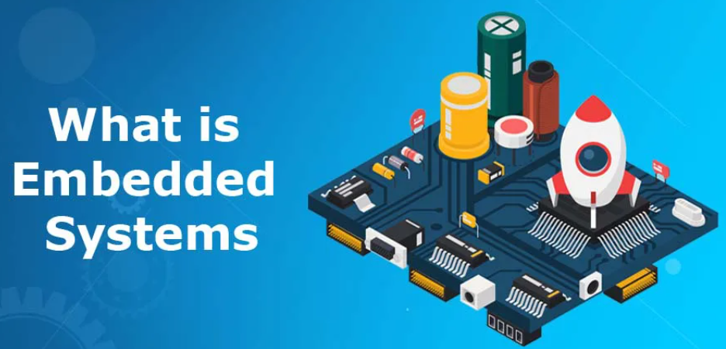
EMBEDDED SYSTEM
“An embedded system is a combination of computer hardware and software designed for a specific function”

Slide 42



ROLE OF AN EMBEDDED SYSTEMS
The Silent Intelligence
The intricate network of embedded systems silently orchestrating modern technology, enhancing efficiency, and automating everyday tasks.
The Nervous System of IoT
Serving as the neural network, embedded systems play a pivotal role in connecting, sensing, and controlling devices within the vast ecosystem of the Internet of Things.
Bridging the Physical and Digital Realms
Acting as the bridge between the physical and digital worlds, embedded systems seamlessly merge hardware and software to power diverse applications in our connected environment.

Slide 43
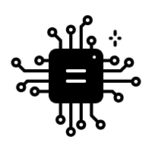

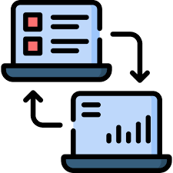

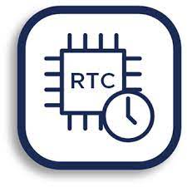
BUILDING BLOCKS
Microcontroller
Central Processor
Memory
Data Storage
Communication
Data Exchange
Sensors/Actuators
Real-time clock
Input perception/output execution
Timing precision

Slide 44
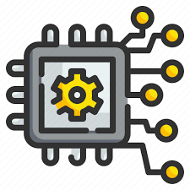
EMBEDDED SYSTEM
SYNERGY OF ELECTRONICS AND EMBEDDED SYSTEMS
Integration of Electronics
Embedded Intelligence
Electronics empower embedded systems with the intelligence to interact with the surrounding environment. Through the integration of sensors and processing units, electronics enable embedded systems to sense, process, and respond to real-world data, facilitating automation and smart functionalities.
Embedded systems heavily rely on electronic components, including microcontrollers, sensors, and actuators, to perform dedicated functions. Electronics serve as the foundational building blocks for embedded systems, providing the necessary hardware for computation and control.

Slide 45
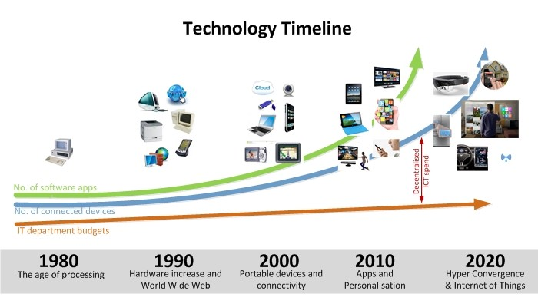
TECHNOLOGY TIMELINE

Slide 46
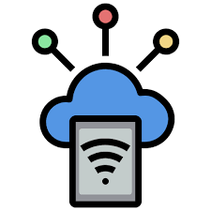
Internet Of Things
INTRO TO
INTERNET OF THINGS
Exploring the heart of Technology

Slide 47
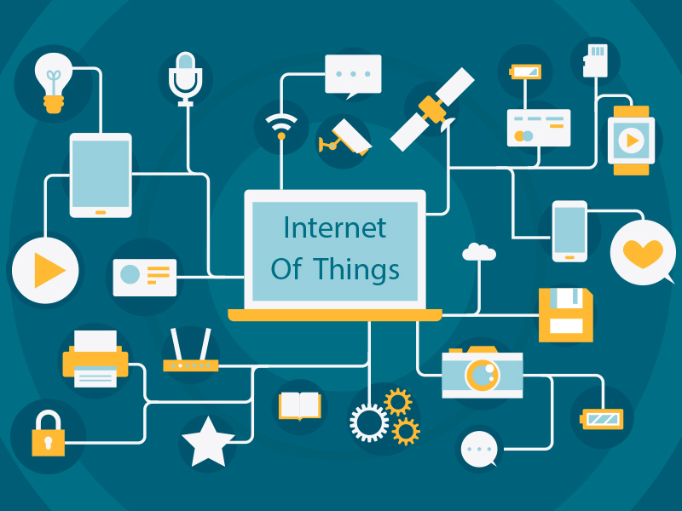
What is Internet Of Things
“IoT, or the Internet of Things, revolutionizes our world by connecting everyday devices to the internet, enabling data exchange and smarter functionalities.”

Slide 48
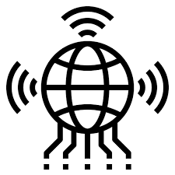
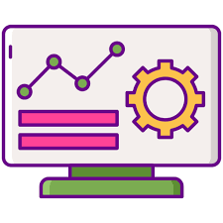
ROLE OF IoT
Seamless Connectivity
IoT enables devices to seamlessly communicate with each other, fostering efficient data exchange and coordination.
Data-driven decision making
By collecting and analyzing data from connected devices, IoT allows for informed decision-making, optimizing processes and improving outcomes.
Automation and Remote Control
IoT facilitates automation and remote control of devices, empowering users to monitor, manage, and control various aspects of their environment from anywhere.

Slide 49
IoT MARKET
4
Industrial Automation
Efficient process control
Precision Agriculture
Effective resource management
3
Wearable Health Devices
Life-saving monitoring
2
Smart Home Automation
Seamless control and monitoring
1

Slide 50
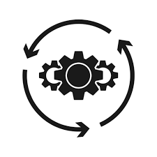

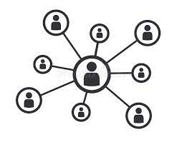
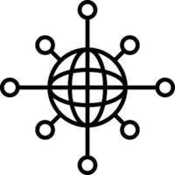
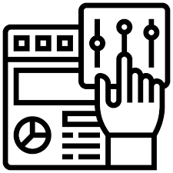
BASIC COMPONENTS
Data Processing
Analyze and process the collected data to derive meaningful insights.
Networking
Sensors/Devices
Facilitate communication between the components, ensuring seamless data flow.
Collect data from the environment or the object.
Secure Connectivity
User Interface
Transmit data securely to the cloud or another storage and processing system.
Display the processed information to the end-user through a dashboard or application.

Slide 51
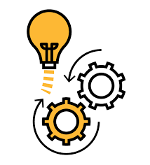
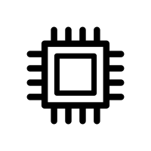
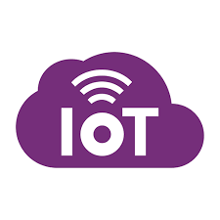
RECAP!
ELECTRONICS
EMBEDDED SYSTEMS
IOT

Slide 52

Questions?

